Slide 1









RSVP Movies Case Study
(Segment-4)

Slide 2

PROBLEM BACKGROUND
RSVP Movies is an Indian film production company which has produced many super-hit movies. They have usually released movies for the Indian audience but for their next project, they are planning to release a movie for the global audience in 2022.
The production company wants to plan their every move analytically based on data and have approached us for help with this new project. We have been provided with the data of the movies that have been released in the past three years. We have to analyze the data set and draw meaningful insights that can help them start their new project.

Slide 3
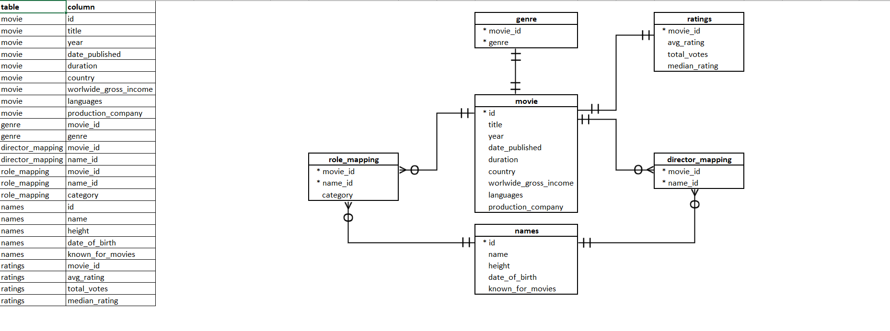
DATABASE SCHEMA

Slide 4
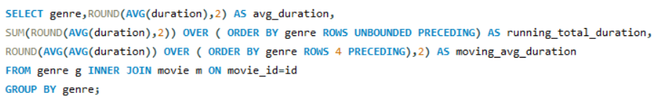
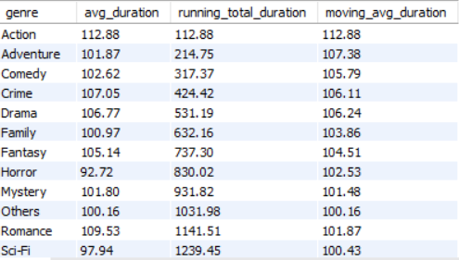
Q1.What is the genre-wise running total and moving average of the average movie duration?

Slide 5
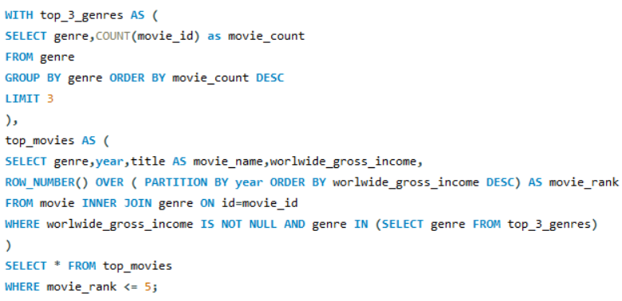
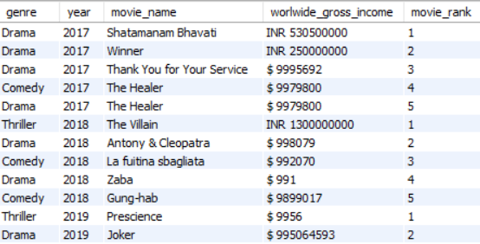
Q2. Which are the five highest-grossing movies of each year that belong to the top three genres?

Slide 6
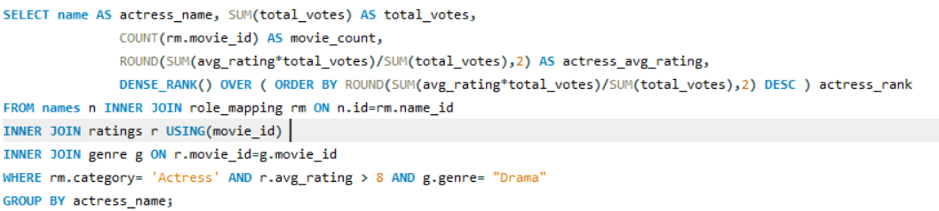

Q3. Which are the top two production houses that have produced the highest number of hits (median rating >= 8) among multilingual movies?

Slide 7
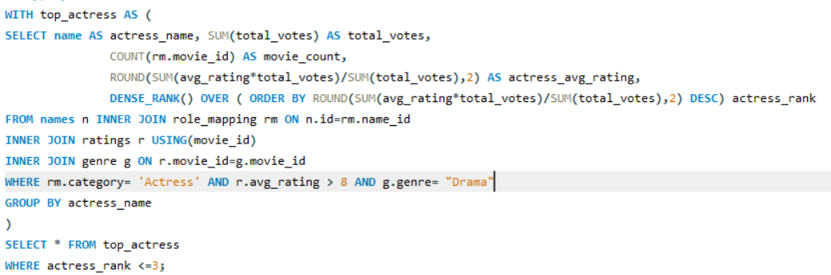
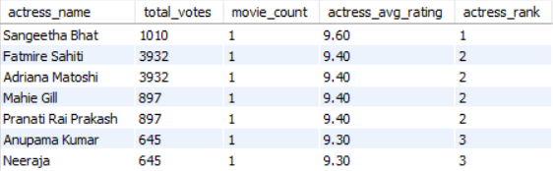
Q4.Who are the top 3 actresses based on number of Super Hit movies (average rating >8) in drama genre?

Slide 8
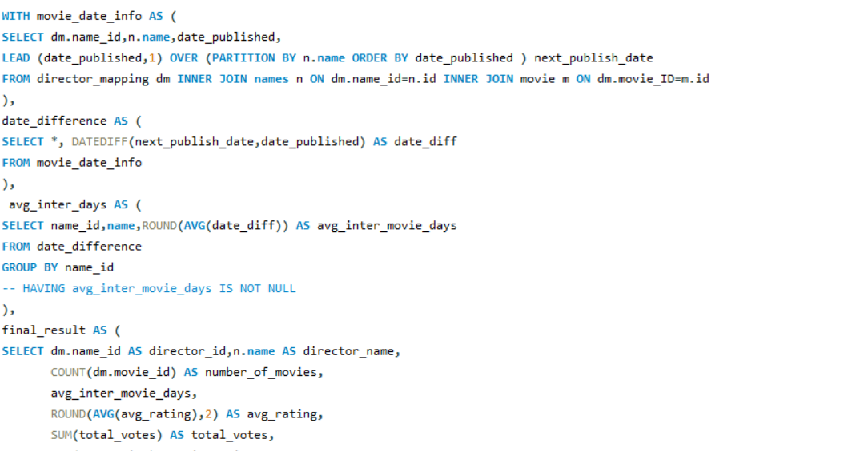
Q5.Get the following details for top 9 directors (based on number of movies):
Director id, Name, Number of movies, Average inter movie duration in days, Average movie ratings, Total votes,
Min rating, Max rating

Slide 9
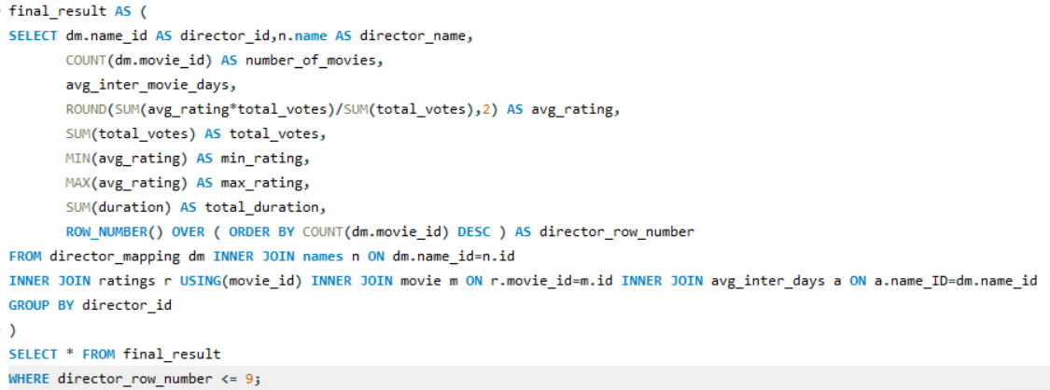
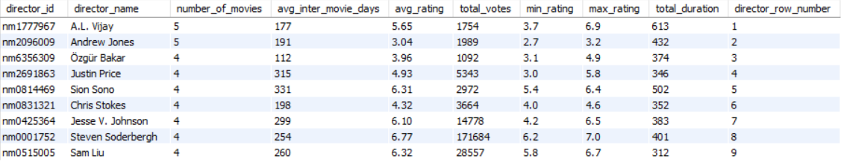

Slide 10

SUMMARY
Shatamanam Bhavati’ is the highest earning movie in the year 2017, ‘The Villain’ is the highest earning movie in the year 2018, ‘Prescience’ is the highest earning movie in the year 2019.
‘Star Cinema’ and ‘Twentieth Century Fox’, are top two production houses that have produced the highest number of hits (median rating >= 8) among multilingual movies.
Sangeetha Bhat is the top actress based on number of Super Hit movies (average rating >8) in drama genre across the globe with an average rating of 9.6.
A.L. Vijay has directed highest number of movies ,5. Out of these , it has got minimum rating as 3.7 and maximum rating as 6.9 which averages to 5.6. His movies have collected a total of 1754 votes from audience. He releases a movie with an average interval of 177 days.

Slide 11
THANK YOU!

